Slide 1
Interim Report Presentation a Used Car Price Prediction Using Machine Learning Techniques
Submitted by:
PRASSANTH E
ANN MARIA john
PRATIK ASARKAR
PRIYANKA PARLIKAR
RUDRA PRATAP SEN
Mentor: Mr. Srikar Muppidi
Batch: DSE DEC 2019, Bangalore

Slide 2
Problem Statement
Need for a used car price prediction system: To effectively determine the worthiness of the car using a variety of features.
Target Business: Online Used-car dealers
Target Customers

Slide 3
Revenue Generation
Google Ad-Revenue
Target Marketing: Target Ad based on user profile
Subscriptions

Slide 4
Data Dictionary
Numerical Features
Feature Name | Feature Description | Min. | Max. | Std. Deviation
Price | The price on the ad to sell the car | 0 | 2147484000 | 3587954
Year of Registration | Year in which the car was first registered | 1000 | 9999 | 92.866598
Power (PS) | Power of the car in PS | 0 | 20000 | 192.139578
Kilometer | How many kilometers the car has driven | 5000 | 150000 | 40112.337051
Month of Registration | At which month the car was first registered | 0 | 12 | 3.712412
No. of pictures | Number of pictures in the ad | 0 | 0 | 0
Postal code | Postal code of the city where the car is available. | 1067 | 99998 | 25799.08247

Slide 5
Data Dictionary
Categorical Features
Feature Name | Feature Description | Number of Categorical Values
Name | Name of the car | 233531
Seller | Private or dealer | 2
Offer type | Offer or Application | 2
A/B Test | Test or Control | 2
Vehicle type | Describes the type of Vehicle | 8
Gearbox | Whether the car has manual or automatic gearbox | 2
Model | The model of a car is the name used by a manufacturer to market a range of similar cars | 251
Fuel type | The Fuel system on which the car runs | 7
Brand | The Brand which the car belongs to | 40
Not repaired damage | If the car has a damage which is not repaired yet | 2

Slide 6
Data Dictionary
Date-Time Features
Feature Name | Feature Description | Unique Values | First Value | Last Value
Date crawled | When this ad was first crawled, all field-values are taken from this date | 280500 | 2016-03-05 | 2016-04-07
Date created | The date for which the ad at EBay was created | 114 | 2014-03-10 | 2016-04-07
Last seen online | When the crawler saw this ad last online | 182806 | 2016-03-05 | 2016-04-07

Slide 7
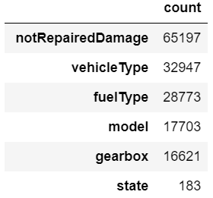
Data Cleaning
Price
Isolation forest anomaly detection technique
Range considered : 100 to 100,000 euro
PowerPS
Isolation forest anomaly detection technique
Range considered : 40 to 800 PS
Missing Value Imputation

Slide 8
Data Cleaning
Feature Extraction
ageOfVehicle
No_of_days_online
State
CountryOfManufacture
Feature Selection
Dropped features based on Statistical Tests : abtest
Imbalanced features : seller, offerType
Redundant features: dateCrawled, noOfpictures
Feature Engineering
Low cardinality features : One Hot Encoding
High cardinality features : Count, Frequency, Mean, K-Fold Target, One Hot Encoding

Slide 9
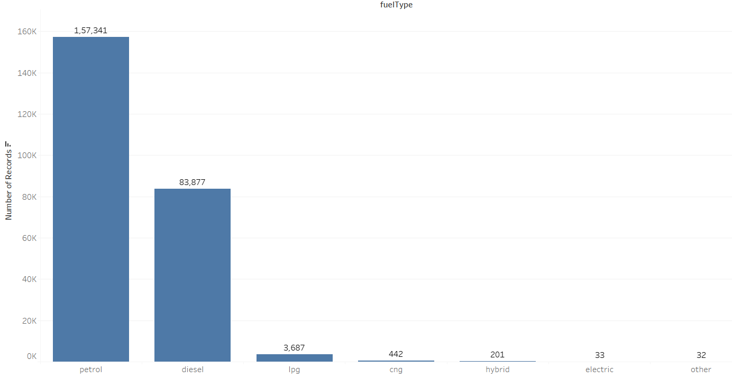
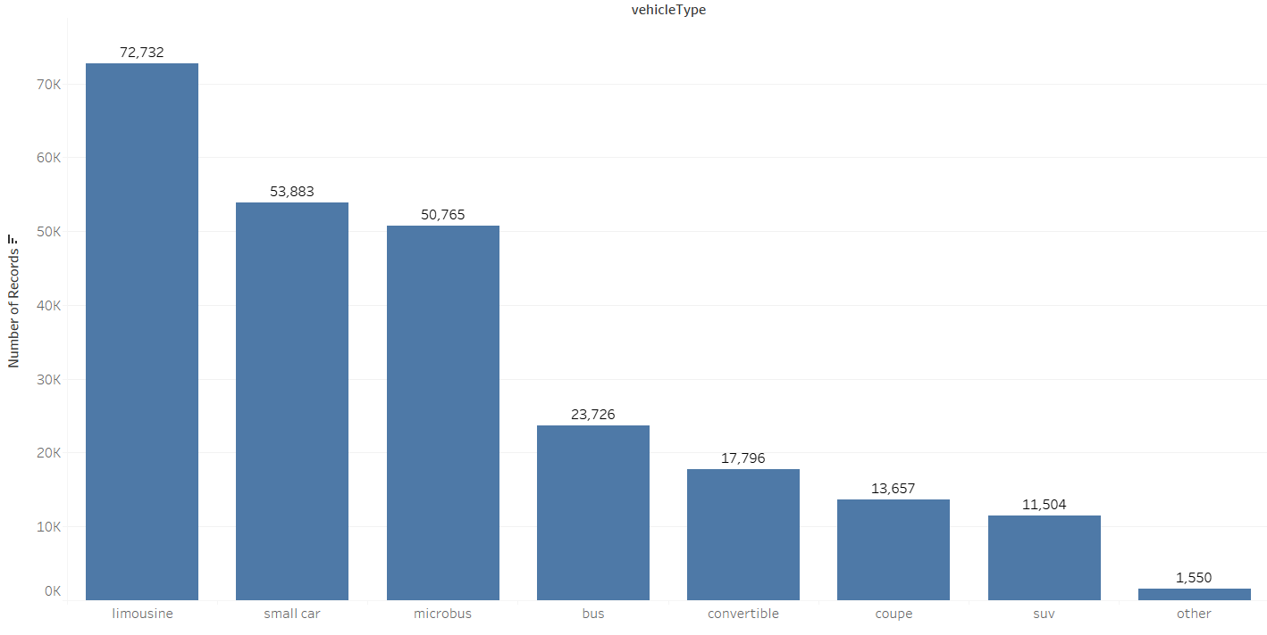
Exploratory Data Analysis – Univariate Analysis
Count of fuelType
Count of vehicleType

Slide 10
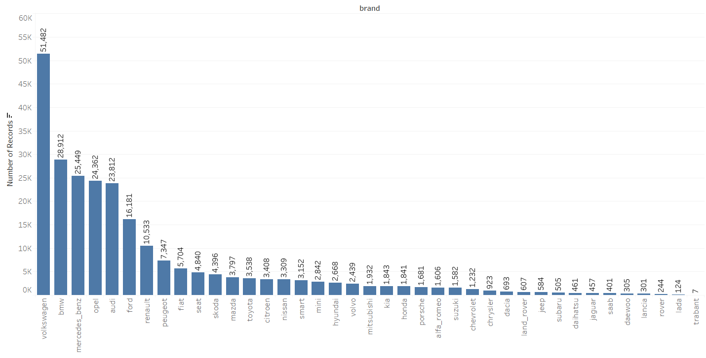
Exploratory Data Analysis – Univariate Analysis
Count of Brand

Slide 11
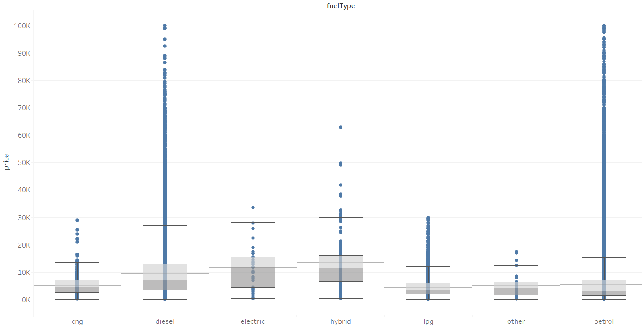
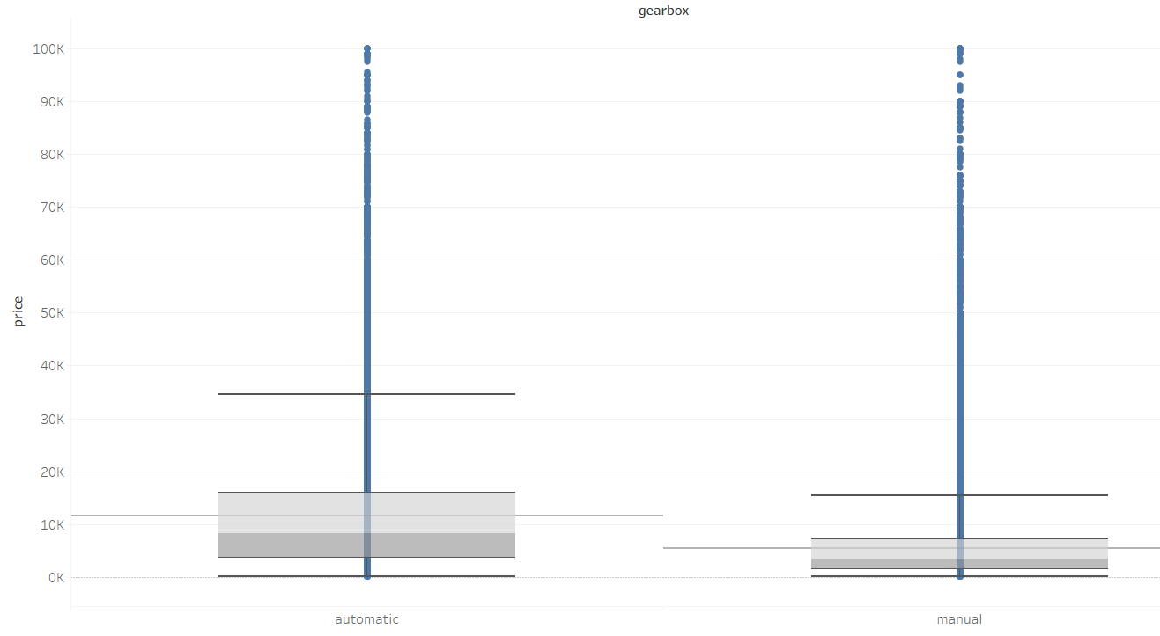
Exploratory Data Analysis – Bivariate Analysis
Price v/s fuelType
Price v/s gearbox

Slide 12
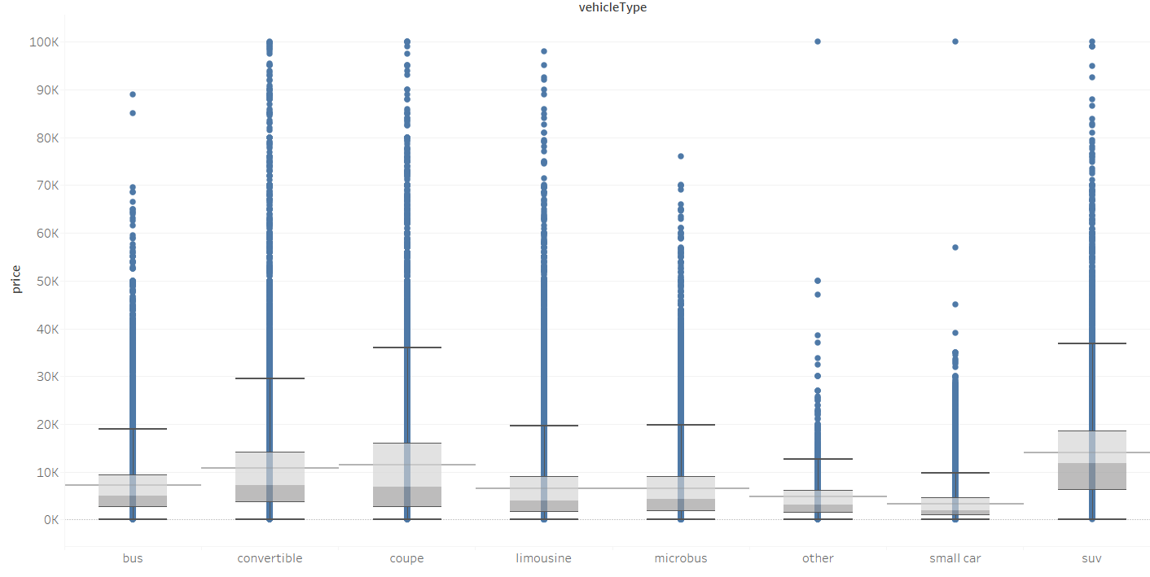
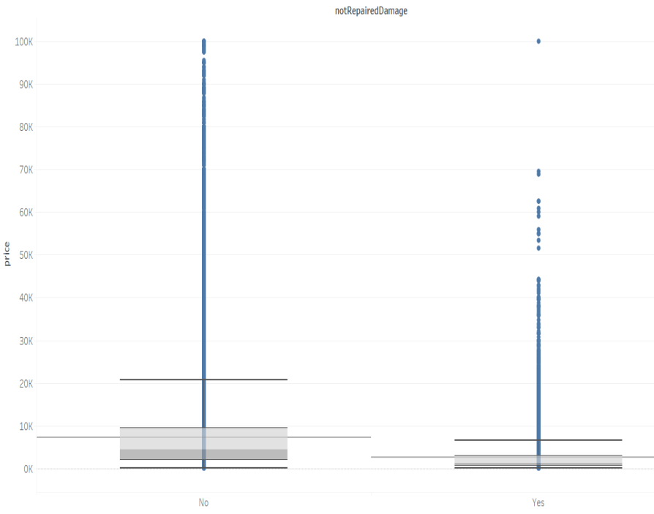
Exploratory Data Analysis – Bivariate Analysis
Price v/s vehicleType
Price v/s notRepairedDamage

Slide 13
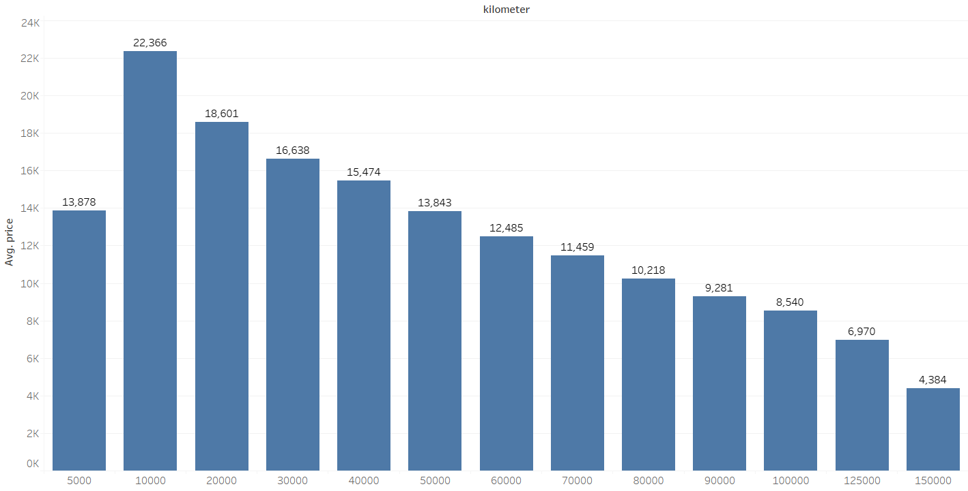
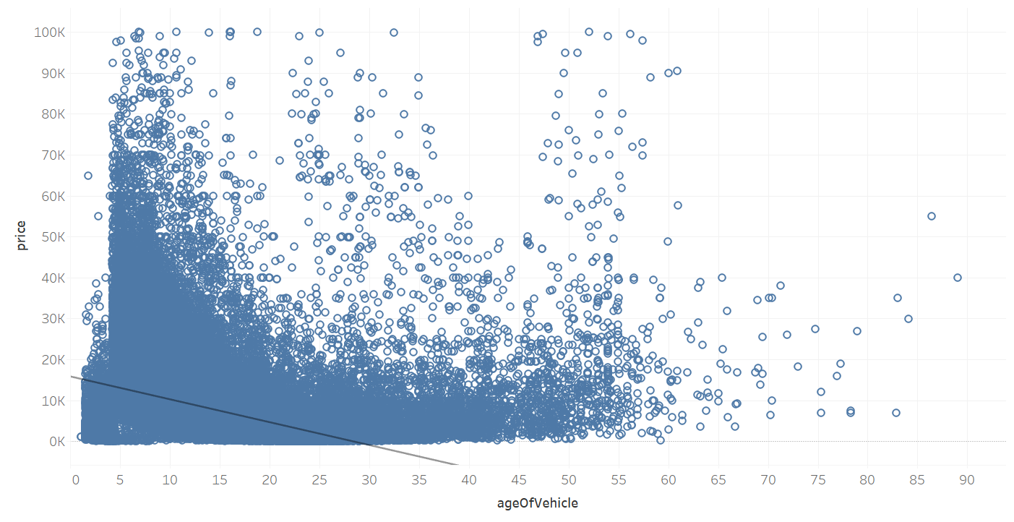
Exploratory Data Analysis – Bivariate Analysis
Price v/s Kilometer
Price v/s ageOfVehicle

Slide 14
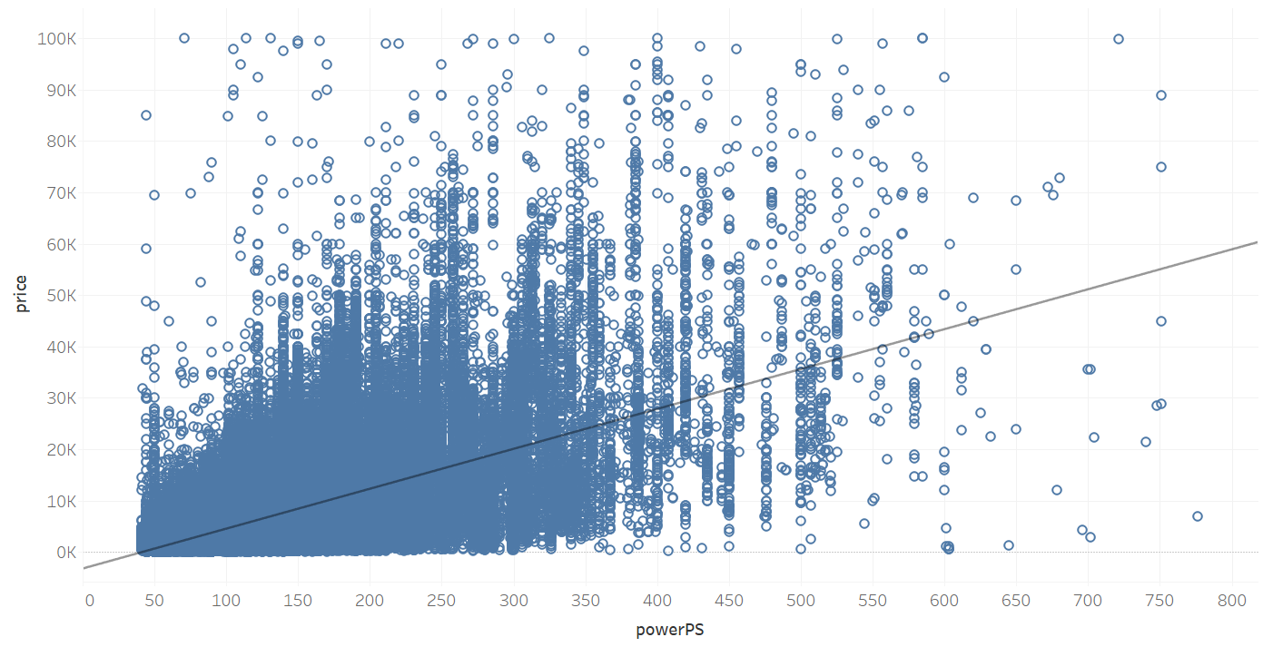
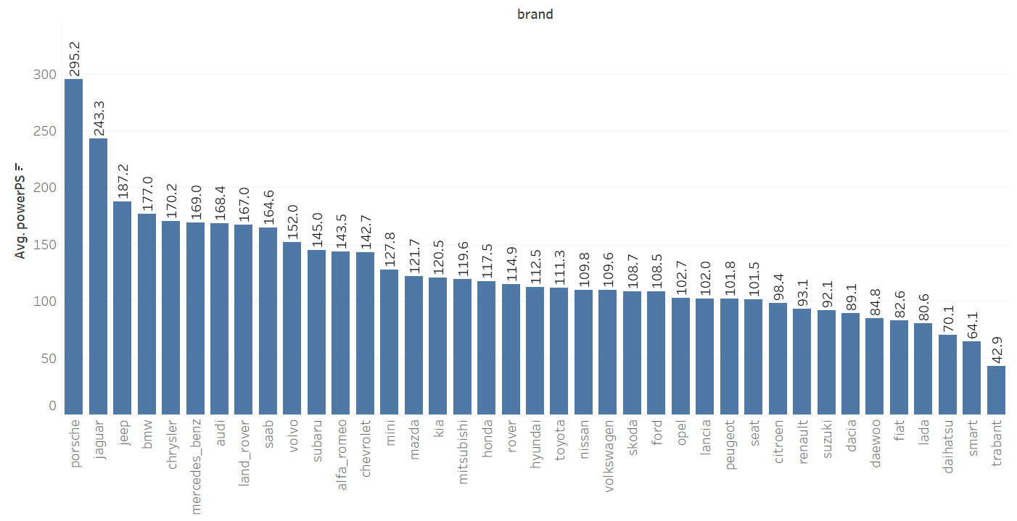
Exploratory Data Analysis – Bivariate Analysis
Price v/s PowerPs
Average Price v/s brand

Slide 15
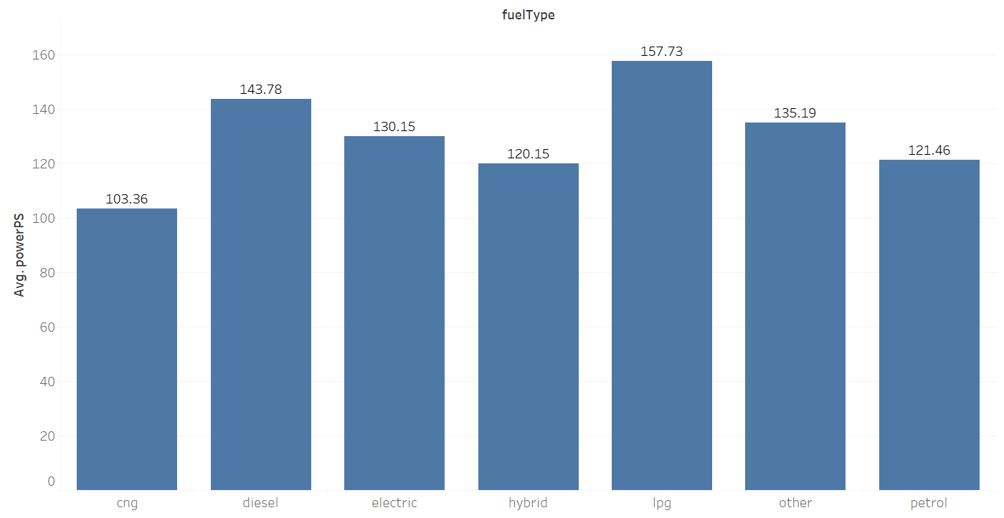
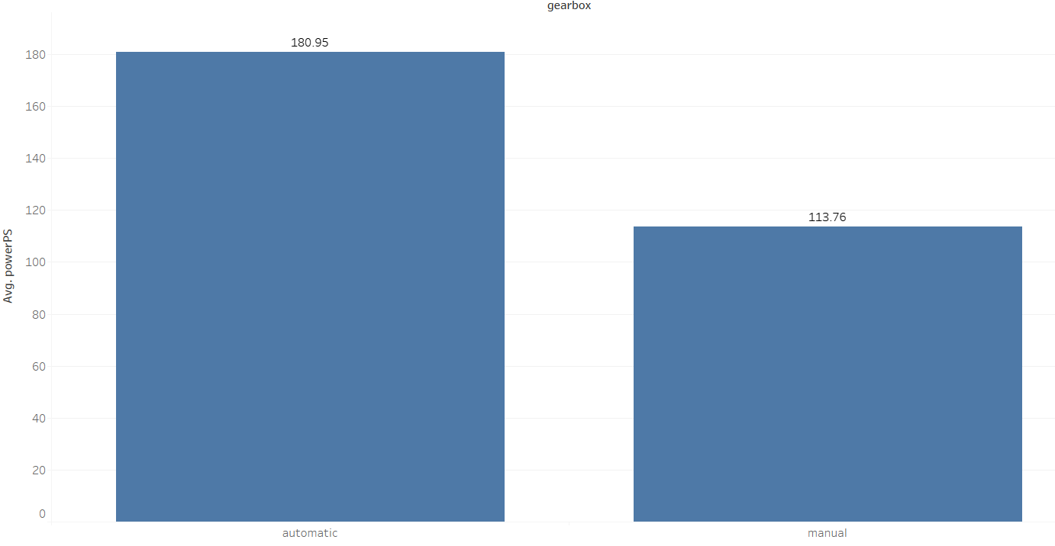
Exploratory Data Analysis – Bivariate Analysis
Average powerPS and fuelType
Average powerPS and gearbox

Slide 16
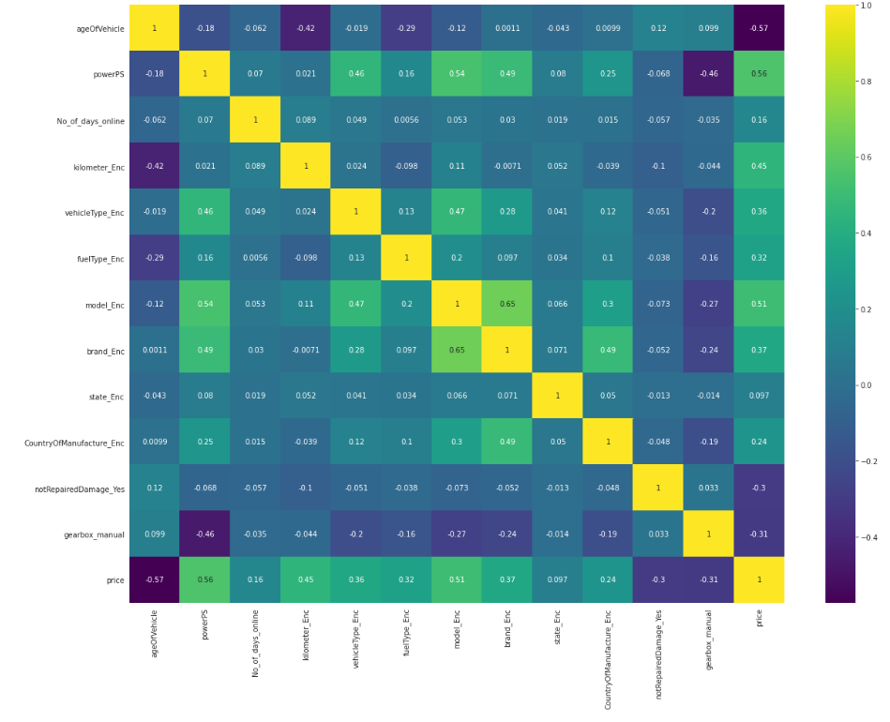
Exploratory Data Analysis – Multivariate Analysis
Correlation Matrix

Slide 17
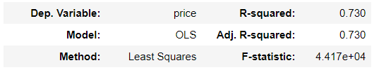
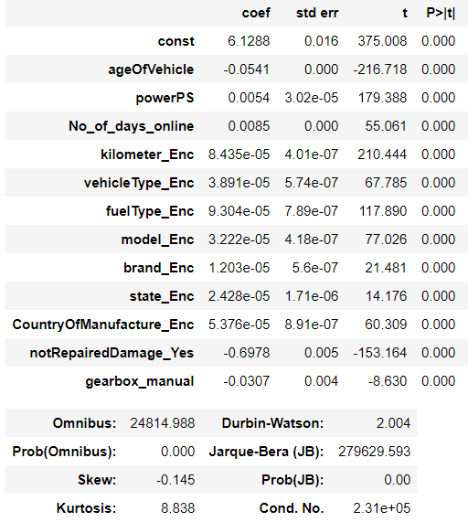
Base Model

Slide 18
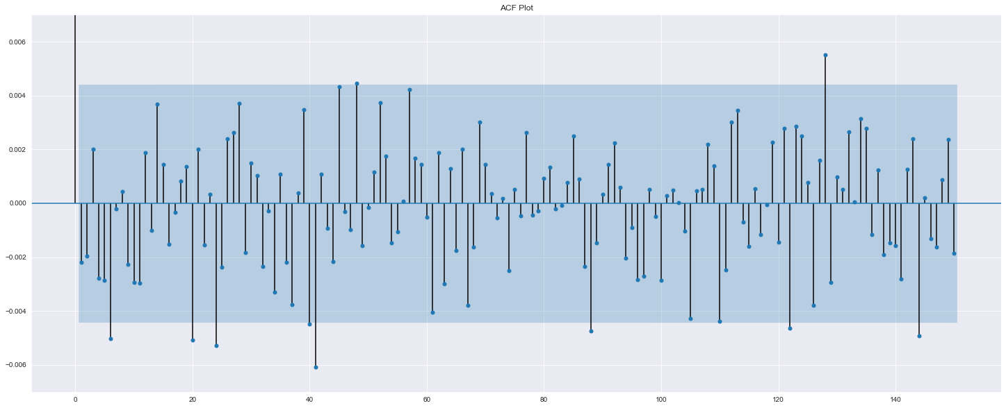
Assumptions of Linear Regression
No Auto Correlation
Durbin-Watson test value : 2.004
ACF plot

Slide 19
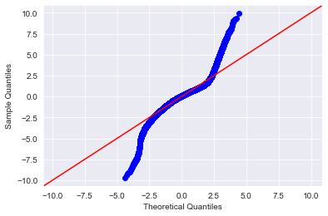
Assumptions of Linear Regression
2. Normality of Residuals
The Jarque Bera test resulted in a p-value of 0.0 along with a test statistic value of 279727.82 which is greater than the t-critical value of 5.99.

Slide 20
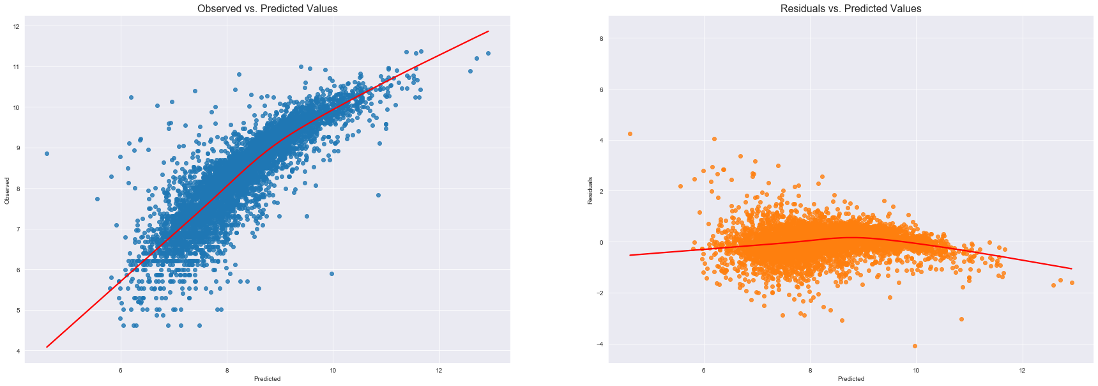
Assumptions of Linear Regression
3. Linearity of Residuals
P-value of 0.377 for Linear Rainbow test which is higher than 0.05.

Slide 21
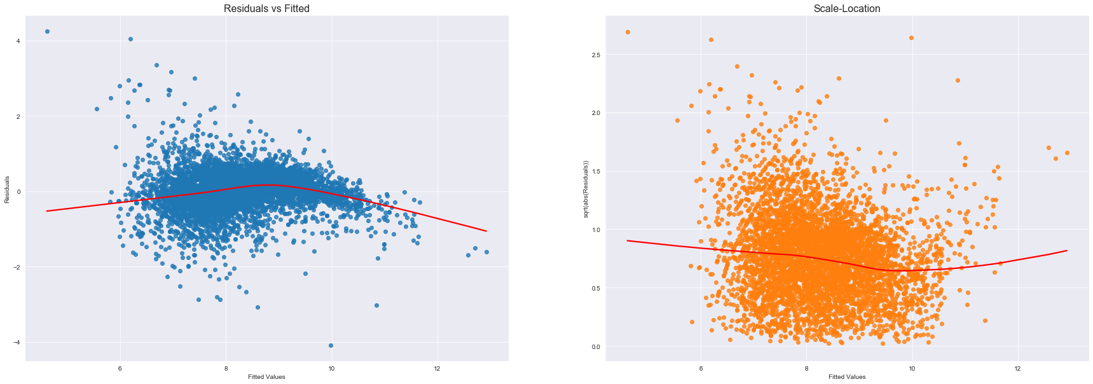
Assumptions of Linear Regression
4. Homoscedasticity
The Goldfeld-Quandt test gives a p-value of 0.3132 which is higher than 0.05.

Slide 22
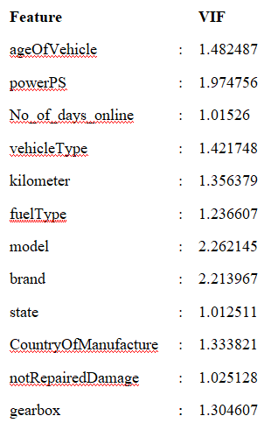
Assumptions of Linear Regression
5. No multicollinearity
Values of more than 4 or 5 are regarded as being moderate to high, with values of 10 or more being regarded as very high.

Slide 23
Thank You

